Slide 1
Presents
A Community Café: The Impact of Screen Usage on Children and Families
May 23, 2024
www.southingtonearlychildhood.org
© 2024 Early Childhood Collaborative of Southington
Notes:
Will share slides.

Slide 2
Agenda
Welcome and Introductions
What and Why
Recommendations
Sparkler
Building a "Kit"
Speaker – Kristin Rouse
What can we do?
Notes:
Will share slides

Slide 3
Welcome and Introductions

Slide 4
Mission: Collaborating to ensure Southington’s children are healthy and prepared to learn through advocacy, programs, resources, and support.

Slide 5
Introductions
Joanne Kelleher, Executive Director
Betsy Mintz, Parent Ambassador
Jessica Springer-Cap, Parent Ambassador

Slide 6
Who are you?
Now that you’ve met us, tell us about you and your reason for being here tonight.

Slide 7
What is a Community Café?
Opportunity for parent engagement
Promote strong parent leaders
Many to many conversation, not just a presentation
Facilitated dialogue and interaction around a central idea of theme

Slide 8
Community Agreement
Your expectations
Photos
Summary report

Slide 9
Why this topic?
On average, children ages 8-12 in the United States spend 4-6 hours a day watching or using screens, and teens spend up to 9 hours. (AACAP) Most of which is recreational not educational.
Kids with difficult temperaments/ADHD/Self-Regulation issues/Socio-emotional. Delays more likely to spend too much time on screens.

Slide 10
Why this topic?
Excessive screen-time in early childhood can lead to cognitive, language and socio-emotional delays. Poor executive function in preschoolers.
1-2 hours of screen exposure in early childhood connected to higher levels of aggression, sleep disturbances, obesity, lower math/school achievement... - Paul Weigle, Campaign for Commerical Free Childhood at https://fairplayforkids.org/

Slide 11
Recommendations
American Academy of Pediatrics
The American Academy of Child and Adolescent Psychiatry
NAEYC
Digital ResponsAbility

Slide 12
There is no research showing that when children younger than 2 years old use screen media independently it enhances their development.

Slide 13
American Academy of Pediatrics
Younger than 18 months, discourage use of screen media other than video-chatting.
18 to 24 months of age, choose high-quality programming/apps and use them together with children
Age 2 -5, limit media to 1 hour or less per day of high-quality programming.
No screens during meals and for 1 hour before bedtime.
Keep bedrooms, mealtimes, and parent–child playtimes screen free.
https://www.aap.org/en/patient-care/media-and-children/

Slide 14
American Academy of Pediatrics
Develop, consistently follow, and routinely revisit a Family Media Use plan.
https://www.healthychildren.org/English/fmp/Pages/MediaPlan.aspx

Slide 15
Similar guidelines to AAP.
https://www.aacap.org/AACAP/Families_and_Youth/Facts_for_Families/FFF-Guide/Children-And-Watching-TV-054.aspx

Slide 16
Technology and Interactive Media as Tools in Early Childhood Programs Serving Children from Birth through Age 8
A joint position statement issued by the National Association for the Education of Young Children and the Fred Rogers Center for Early Learning and Children's Media at Saint Vincent College. (1/2012)
www.naeyc.org/resources/topics/technology-and-media
Read the Position Statement (PDF)
View Key Messages Summary (PDF)

Slide 17
NAEYC Key Messages
When used intentionally and appropriately, technology and interactive media are effective tools to support learning and development.
Intentional use requires early childhood teachers and administrators to have information and resources regarding the nature of these tools and the implications of their use with children.
Limitations on the use of technology and media are important.
Special considerations must be given to the use of technology with infants and toddlers.
Attention to digital citizenship and equitable access is essential.
Ongoing research and professional development are needed.

Slide 18
NAEYC Effective Practice
Examples of Effective Practice with Infants and Toddlers
Examples of Effective Practice with Preschoolers and Kindergarteners
Examples of Effective Practice with School-Age Children

Slide 19
Blog
Classes
Videos
Books
https://respons-ability.net/

Slide 20
The 3Ms of Fearless Digital Parenting: Proven Tools to Help You Raise Smart and Savvy Online Kids by Carrie Rogers-Whitehead
Model good tech behavior (age 0-8)
Manage a growing tween’s digital life
Monitor their teen’s behavior and mentor

Slide 21
Additional Resources
Child Mind Institute -Screen Time & Technology, Learn how to help kids use screens in a healthy way. https://childmind.org/topics/screen-time-technology/
Sesame Workshop – Managing Screen Time. https://sesameworkshop.org/resources/maes-minute-screen-time-routines/

Slide 22
Sparkler and Developmental Screening
www.southingtonearlychildhood.org/sparkler/

Slide 23
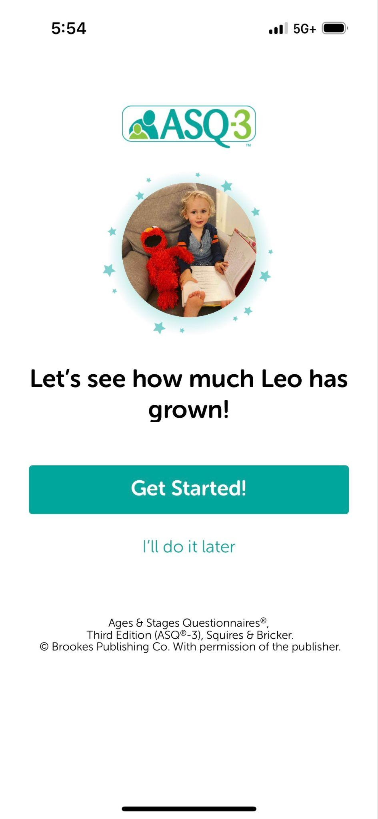
Sparkler is the MOBILE Way for Families to Access ASQ
By using Sparkler’s mobile app, families can access developmental screening whenever, wherever.
Mobile access means:
More access to screening for families with young children, age 5 and under
More equitable access to screening
Notes:
Julia

Slide 24
What Does the ASQ-3 Measure?
The ASQ-3 covers 5 domains of development:
Communication
(Words)
Gross Motor
(Body)
Fine Motor
(Body)
Problem-Solving
(Mind)
Personal-Social
(Heart)
Notes:
Julia

Slide 25
What Does the ASQ:SE Measure?
The ASQ:SE-2 measures SEVEN core social-emotional behavioral areas:
Self-regulation — A child's ability or willingness to calm or settle down or adjust to physiological or environmental conditions or stimulation
Compliance — A child's ability or willingness to conform to the direction of others and follow rules
Adaptive functioning — A child's success or ability to cope with physiological needs (e.g., sleeping, eating, elimination, safety)
Autonomy — A child's ability or willingness to self-initiate or respond without guidance (i.e., independence)
Affect — A child's ability or willingness to demonstrate his or her own feelings and empathy for others
Social-communication — A child's ability or willingness to interact with others by responding to or initiating verbal or nonverbal signals to indicate interests or needs, feelings, and affective or internal states
Interaction — A child's ability or willingness to respond or to initiate social responses to parents, other adults, and peers.
Social Emotional
(Heart)
Notes:
Julia

Slide 26
Now it is your turn!
Let's make a kit ….
Family Agreement Activity ...

Slide 27
Conversation
Speaker: Kristin Rouse, LCSW
Helping children and families thrive locally here in Southington. Kristin is a licensed clinical social worker at Healing Springs Wellness Center, Plantsville
https://healingspringswellness.com

Slide 28
Media Literacy As Children Grow
Advertising
Gaming
Online Safety – passwords, phishing, etc.
Digital Privacy
Stunts and challenges encouraging unsafe behavior
Exposure to violence and misleading info
Sexting, Sexual Content and Pornography
Cyberbullying

Slide 29
Community Conversation
What are your thoughts?
What resonated with you?
What other needs are there in the community?
All comments are welcome.

Slide 30
Wrap-up and Next Steps

Slide 31
Thanks to Community Cafe Supporters

Slide 32
Survey
What other needs are there in the community?
Topics for future Community Cafes?
How can we work together?
What else can the ECCS do?

Slide 33
Questions?
Joanne C. Kelleher
Executive Director
Early Childhood Collaborative of Southington
P.O. Box 210, Southington, CT 06489
www.southingtonearlychildhood.org
https://www.facebook.com/ECCSouthington/
https://twitter.com/ecc_southington
https://instagram.com/eccsouthington
C: 860-385-1665
Notes:
Follow us on social media.

